Slide 1
Employee Management
By: A.B.M Rafiul Hasan (181014072)
Efat Jahan Ema (172014064)
Sakib Ahmed Pathan Taif (192014045)

Slide 2
Objectives
Adding Employee data in a data database.
Displaying table of data in a list.
Searching for data.
Add, update and delete data from the table.
Incorporated with database for a better user-friendly experience.
Easy to follow.

Slide 3
Requirements and outcomes
Built with:
Visual Studio
Notepad++
Xampp
Requirements:
Knowledge in HTML, CSS, PHP, JavaScript and MySQL.
Front-end done in CSS and PHP.
Back-end done in HTML, CSS, PHP, JavaScript and MySQL.

Slide 4
Overview
Login page: It is used to login into the application for the admin. It has a box to put ID and password.
Search: It is used to search for specific employees.
Insert: Adding employee’s details into database.
Landing page: It is used to display Name, SSN, Salary and Department of employees.
Update: It is used to change details about employee in database.

Slide 5
Planning
Employee management System is a software to help someone organize their company. There is a Login page, a page to display the employee’s details in the company in a table and lastly there is a page where we add details about employees. There is a search option for easier searching. It is simple to understand and user friendly. It is not heavy on details about employees, but it is good for handling massive number of employees.

Slide 6
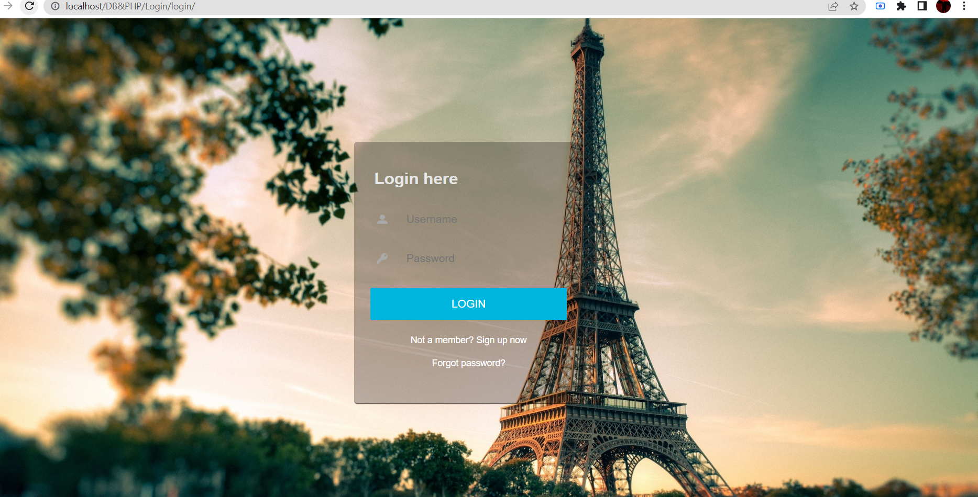

Slide 7
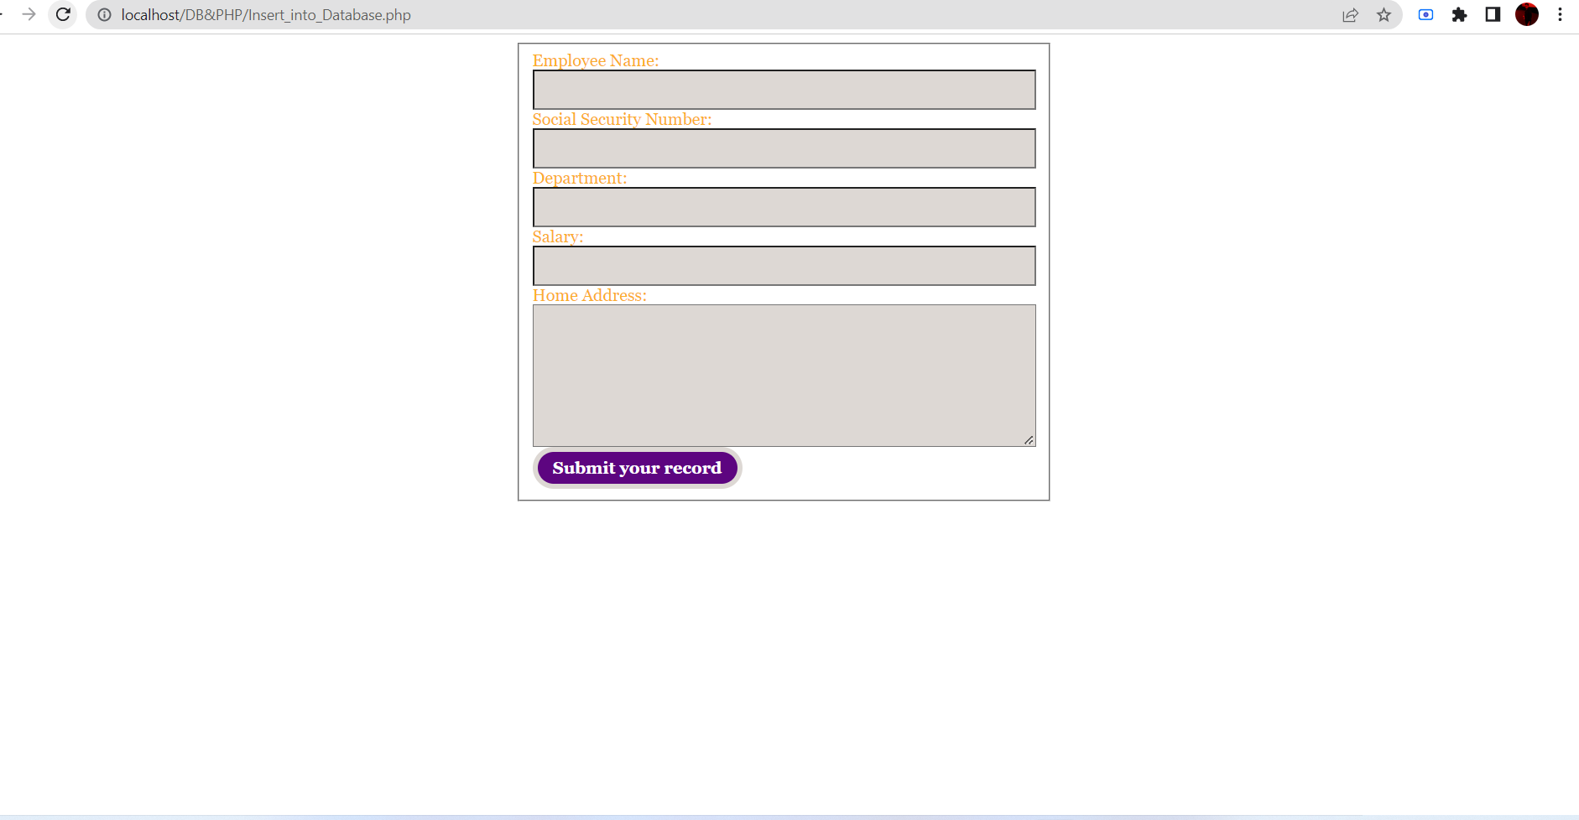

Slide 8
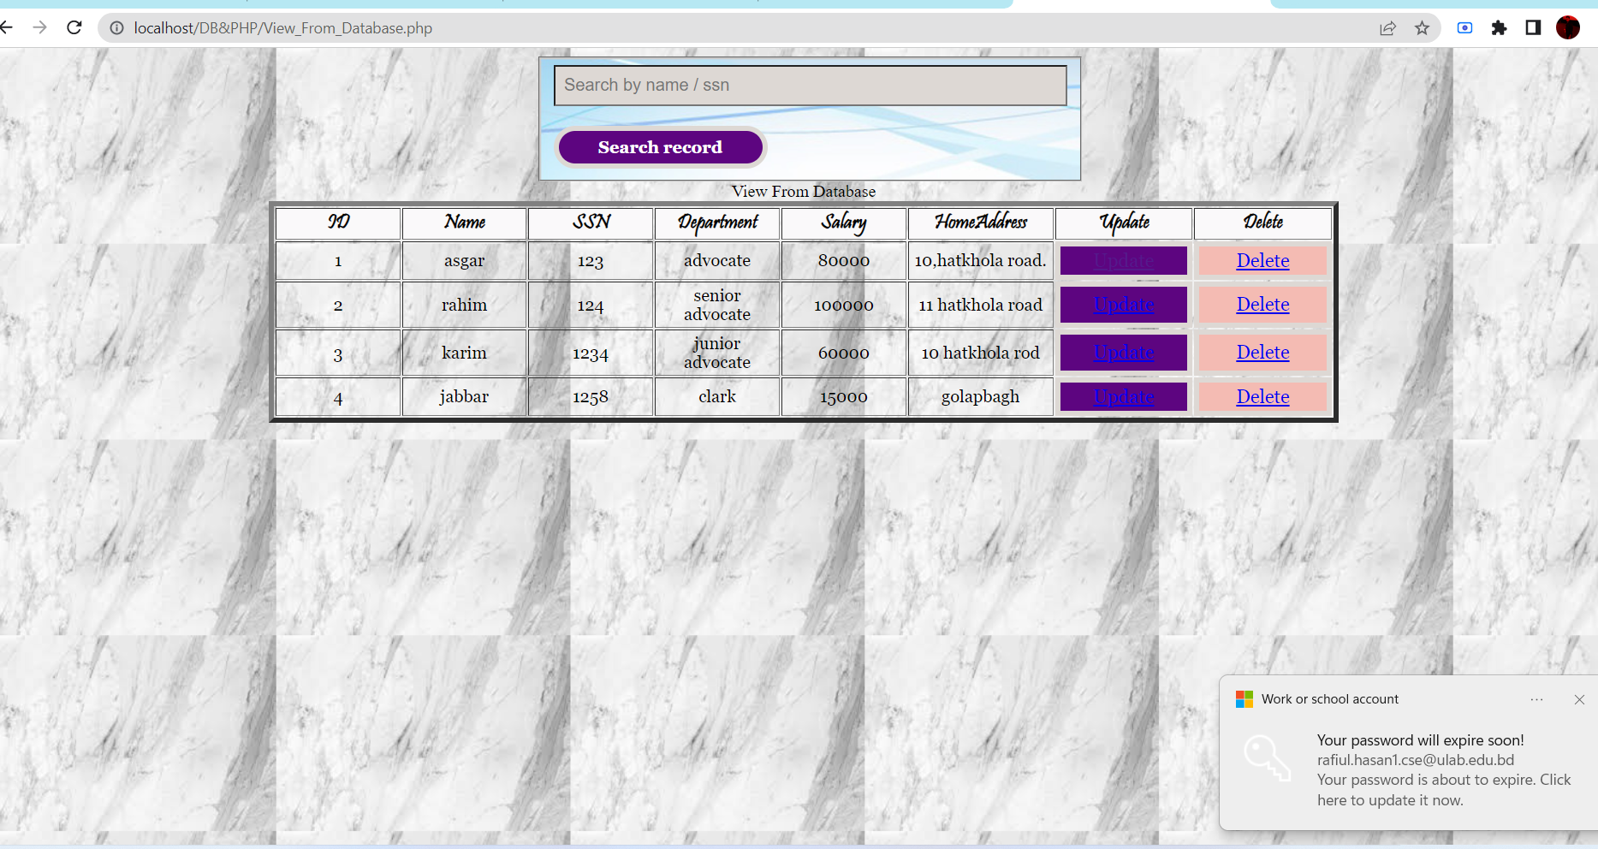

Slide 9


Slide 10
Thank You.

